Slide 1
Creating a Balanced Spending Plan
Presented By:
Samantha Kolb, AVP – Wealth Education Coordinator
Retirement Plan Services
Notes:
WELCOME & INTRODUCTION
The goal of today’s conversation is to provide you with information to help you manage your expenses today and build for tomorrow.

Slide 2

“
A budget isn’t about restricting what you can spend. It gives you permission to spend without regret.”
- DAVE RAMSEY
3
Notes:
Dave Ramsey says is best…”A budget isn’t about restricting what you can spend. It gives you permission to spend without regret”
By Cruz: I like the inclusion of the quote. Provides more comfortability to the presentation and hard topic of budgeting.

Slide 3
“
Budgeting is not just for people who do not have enough money. It is for everyone who wants to ensure that their money is enough.
- ROSETTE MUGIDDE WAMAMBE
Rosette WAMAMBE | LinkedIn
3
Notes:
Dave Ramsey says is best…”A budget isn’t about restricting what you can spend. It gives you permission to spend without regret”
By Cruz: I like the inclusion of the quote. Provides more comfortability to the presentation and hard topic of budgeting.

Slide 4
“
Used correctly, a budget doesn’t restrict you; it empowers you.
- TERE STOUFFER, CMO, JA WORLDWIDE
Tere Stouffer | LinkedIn
3
Notes:
Dave Ramsey says is best…”A budget isn’t about restricting what you can spend. It gives you permission to spend without regret”
By Cruz: I like the inclusion of the quote. Provides more comfortability to the presentation and hard topic of budgeting.

Slide 5
Road to Financial Freedom
1
DETERMINE INCOME
2
TRACK SPENDING
3
MAKE A PLAN
4
MANAGE EXPENSES
MAXIMIZE INCOME

Slide 6
Eight Streams of Income
EARNED
DIVIDEND
Most common type of income. This is money made from working a job.
Some companies pay dividends as a reward to shareholders (stock ownership).
PROFIT
RENTAL
Money made from selling a product or service for a product.
Earned by renting out real estate properties or items owned by you.
INTEREST
CAPITAL GAINS
Earned by lending money to others, typically through a savings account.
When you sell assets such as stocks for more than you bought them.
PASSIVE
ROYALTY
Money made generally through a business on a continuous basis with little effort.
Earned by owning and licensing intellectual property, such as patents or copyrights.

Slide 7
Determine Your Income Streams
SOCIAL SECURITY
You decide when to turn it on…62, 65, 67, 70
www.ssa.gov
2ND JOB / HOBBY
Referee / Coaching
Musician
Side Job
etc…
PAYCHECK
Fulltime Employment
Part-time Employment
Self-Employment
OTHER
Alimony
Child Support
HSA
Inheritance
Interest/Dividends
Rental Income
RETIREMENT
401(k) / 403(b) / 457
Profit Sharing
SIMPLE / SEP
IRA
Roth IRA
etc…
Notes:
SAY:
What money do you currently rely on to cover your bills? (Talk through animation) Track it!
Now, think about other ways to make money. Is it through more work, better spending habits or smarter saving?

Slide 8
How to Organize Your Finances
INCOME
Any pre-tax deductions are taken out here, like your retirement plan contributions
PAYCHECK
EXPENSES
SAVINGS
FIXED EXPENSES
LIVING EXPENSES
LONG-TERM
SHORT-TERM
Bills, Debt, Subscriptions, Health, Insurance
Food, Gas, Clothes, Personal, Fun, Misc.
Retirement, House, Wedding, Baby, etc.
Emergency, Vacation, Gifts
Investment Account
Regular or High-Yield Savings

Slide 9
Stick to a Budget
Add up all income
Track spending – 30 days
Share
Save
Spend
List out debt repayment
No spend challenge
No-Spend Month Challenge: The 7 Rules to Follow | Johnson Financial Group
Creating a Budget | Johnson Financial Group
Notes:
I have provided you with an editable spending plan (or budget) worksheet. I would encourage each of you to complete one on a monthly basis in order to keep track of where your hard-earned dollars are going.
Let’s take a look at the balanced spending sheet in front of you.
Fixed expenses are anything that you pay on an ongoing basis (mortgage/rent, loans, car payment) and payment is consistent.
Variable/Flexible expenses are anything that you pay at various times but are not consistent or are point in time (food, utility bills, clothing, or entertainment/vacations)
I challenge you to try tracking your spending habits.
Pulling bank statements and credit card statements for the last two months should give you a good idea of how you spend your money. If you utilize cash to make most purchases, keep track of receipts or complete a spending log

Slide 10
STOP Living Paycheck to Paycheck
01
Add up ALL of your debt
Make a debt repayment plan
Be brutally honest about where you can make changes
02
x
03
Identify where your money is going
Create a savings strategy
04
Stick to a budget
Determine if you are making enough money
Pretend to make less
Put away the credit cards
Identify your bad money habits / attitudes
Open communication with those impacted on how to handle money
05
06

Slide 11
7 Spending Plan Techniques
Traditional
Snowball
Reverse
Cash Only
Uses prior year budget to predict current year budget
Based around snowball debt repayment plan
Automate your saving and use the rest for expenses
Expenses are paid in cash only (envelope system)
1
3
5
7
2
4
6
50/30/20
Zero Based
80/20
50% Needs
30% Wants
20% Savings/Debt
Income – Expenses = Zero
80% Expenses
20% Savings
Choose the technique that works for you!

Slide 12
Zero-Based Budgeting
-
=
INCOME
EXPENSES
SAVINGS
Money coming IN
Money going OUT
Excess for SAVING
Notes:
SAY:
After a month you’ll have a better idea of what your cash flow looks like and where there is
room for change on your balance sheet.
What I mean by cash flow is
INCOME (the money coming in) – EXPENSES (the money going out) = SAVINGS (excess $)
The goal of a balance sheet is to document habits and find ways to manage expenses.
For you that might be a Starbucks habit or cancelling subscriptions because all of those streaming services really do add up! Maybe it is dining out or a shopping habit.
Regardless of what your spending habits are, managing expenses are all about CHOICES!

Slide 13
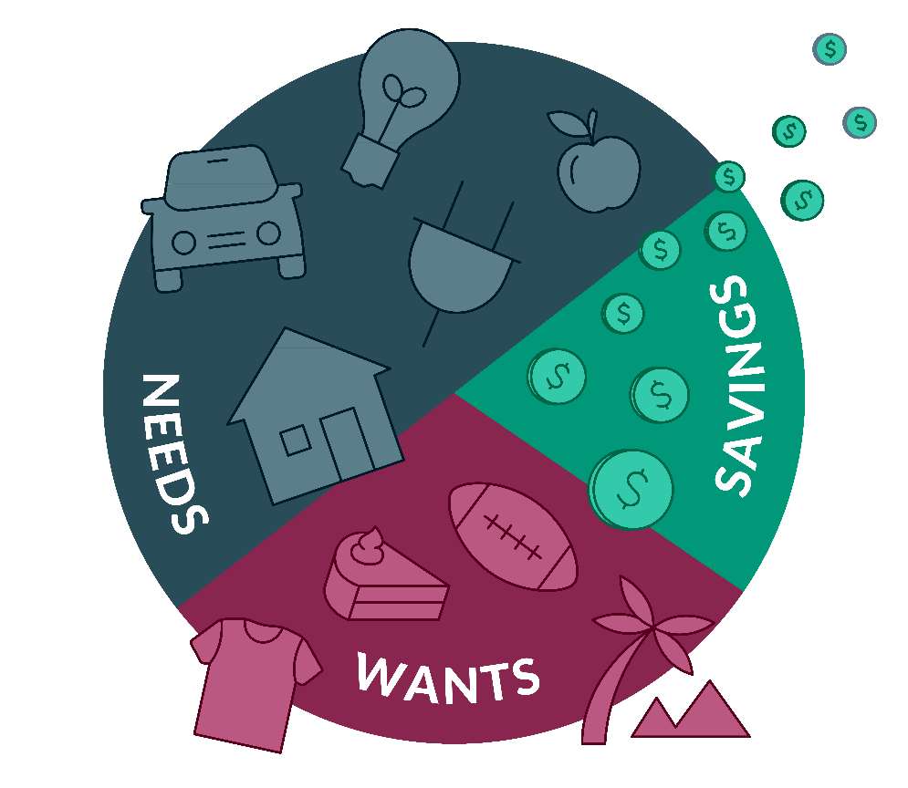

50/30/20 Budgeting
SAVINGS
10%-
15%
50%
20%
30%
GOAL
MAXIMIZE INCOME.
RETIREMENT SAVINGS
Notes:
SAY:
One of the easiest ways to add to your savings strategy is to simply cut expenses. Where your money is going is a humbling conversation to have with yourself.
Creating a spending plan to maximize your income will help you assess your finances.
Know how much money is coming into your household by listing all of your income sources.
Know how much money is going out by tracking your expenses
Lastly, identify how much money you can afford to save each month
Reminder, that writing out your plan and following a spending plan that fits your needs is a first step in order to achieve a savings goal of 10-15% for retirement.
Suggestions by Cruz: I thought all of the illustrations were beneficial to my knowledge from the presentation

Slide 14

Cash Only Budgeting
This method is derived from combining a few different strategies:
Paycheck Method
Calendar Tracking
Envelope System*
*You don’t actually need to use envelopes!
Notes:
The 3rd most frequently used method is related to the cash only budget. This method is derived from combining a few different strategies: the paycheck method, the calendar tracking method as well as the envelope system
Today most payments are done automatically or electronically so there is no need to actually use physical envelopes. Just substitute the envelope for payment tracking. Let’s take a closer look as to what that looks like.
Suggestions By Cruz:
What is the calendar tracking method?
Example?
What is the envelope system
Example?

Slide 15
Manage Expenses to Maximize Income
Ask providers for discounts
Decrease spending when bored
Limit credit card use
Pay bills on time
Pay down debt
Notes:
SAY:
So, this is all great but how? Where do I even begin?
Begin by writing it down, use the worksheet and keep yourself honest.
Have a conversation with your partner/spouse/loved ones.
Find spending leaks…things that you could live without or make less expensive.
Carry little cash to avoid temptation
Control credit card use
Pay your bills on times
Ask service providers for discounts or cash payment options
Pay down debt / remove monthly payments
Decrease shopping for “FUN”…impulse purchases are an easy way to get sidetracked. Wait a day!
*Keep in mind that just because an item is on sale doesn’t mean it’s a good deal*
Decreasing your spending = More money in your pocket

Slide 16
Be SMART about Goals
SPECIFIC
MEASURABLE
ATTAINABLE
RELEVANT
TIME BASED
Notes:
Budgeting goals require you to be SMART or you will be revisiting/reworking your plan often
Specific – what exactly will you do?
Measurable – how will you know if you meet your goal(s)? - celebrate small and large accomplishments
Attainable – goals should be realistic – what steps are you going to take to reach your goals?
Relevant – budget should be relevant to your current lifestyle – why is it important to you?
Time Based – establish a timeline for achievement of each step
Set short term goals to accomplish within a year. Specific purchase goals should be tied to a dollar amount and longer-term goals would be anything over a year timeline.
For example:
Paying down debt (TIP: target items with smaller balances and each time a debt is paid take
that money and apply it to the next item)
Saving for a specific goal (TIP: set aside an envelope or a separate savings account to save cash
until you have enough to purchase the item)
We all make money mistakes so don’t be too hard on yourself. Check yourself on your spending excuses…we ALL have them! Make the choice to make changes and DON’T set yourself up for failure!

Slide 17
Ten Simple Steps to Achieving Financial Freedom
1
No time like the present…START!
If not you, then who?
Spend less than you earn.
Create an emergency fund.
Don’t bother “keeping up with the Jones.’” They may be struggling too!
Pay off high interest debt fast.
7
Create multiple sources of income.
Personal finance is 20% knowledge and 80% behavior
Income does not determine your wealth:
Earns $70K – Spends $69,500
Earns $40K – Spends $30K
You need a spending plan for your money. Revisit it each year.
2
8
3
9
4
5
10
6

Slide 18
Key Takeaways
DELAY THE DAY
Goal or Retirement
MAXIMIZE INCOME
Earn More
Tax Credits
Save Smarter
SPEND LESS
Manage Expenses
Track Spending
Notes:
SAY:
I find that it is best to wrap things up with a key reminder or what I call a takeaway.
There really is only three ways to change habits in order to hit your financial goals.
Make more money or Maximizing your existing income
Spend less
Delay the day
Keep your budget flexible – unexpected expenses will happen
Think LONG TERM…spend wisely, save more

Slide 19
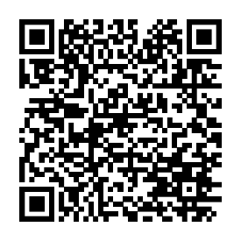

For More Information
Scan the QR Code for more resources!
Participant Account Access: https://participant.johnsonfinancialgroup.com
Download the “Work, Save, Retire” Mobile App
RPS Participant Support Center: RetirementServices@worksaveretire.com
Call: (888) 755-3039, Monday – Friday | 7am to 7pm
Notes:
If you need help with general enrollment questions, please reach out to our RPS Participant Service Center at 888.755.3039 or by emailing retirementservices@worksaveretire.com
Thank you for joining today’s presentation! We look forward to working with you

Slide 20
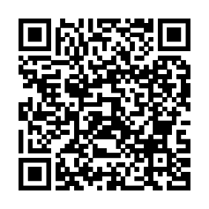
For More Information
Scan the QR Code for more resources!
Participant Account Access: www.yourbenefitaccount.net/pensioninc/
RPS Participant Support Center: (920) 432-7020
Monday – Thursday | 8am to 4pm Friday | 8 am to 2pm
Notes:
If you need help with general enrollment questions, please reach out to our RPS Participant Service Center at 888.755.3039 or by emailing retirementservices@worksaveretire.com
Thank you for joining today’s presentation! We look forward to working with you

Slide 21
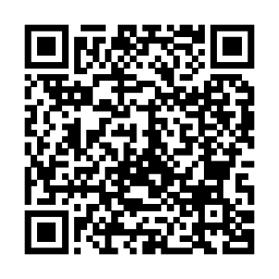
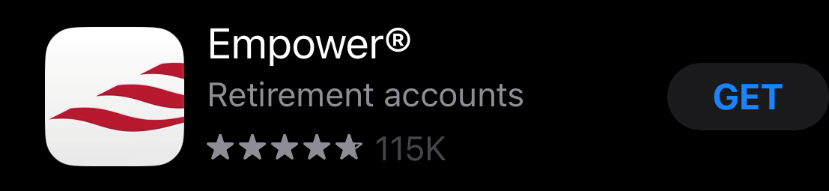
For More Information
Scan the QR Code for more resources!
Participant Account Access: https://empowermyretirement.com
Download the “Empower Retirement” Mobile App
Participant Support Center: Call (800) 338-4015
Notes:
If you need help with general enrollment questions, please reach out to our RPS Participant Service Center at 888.755.3039 or by emailing retirementservices@worksaveretire.com
Thank you for joining today’s presentation! We look forward to working with you

Slide 22
Resources – Work, Save, Retire
Learn More About Our Retirement Plan Experience | Johnson Financial Group
FAQs – instruction sheets to answer any of your questions in navigating the participant web portal
Links to other relevant financial tools and information
Insights Blog | Financial Insights, Industry insights, Investment insights | Johnson Financial Group
Investment Commentary (mostly weekly short-ish blog posts and articles about current economic conditions and insights into what’s driving our current economic moment)
Markets & Economy – Quarterly economic & market updates and forecasts based on current trends
Your Financial Life – (periodic) more general financial planning topics that many people encounter
[PODCAST] Your Money. Your Mission. | Johnson Financial Group
We also have a new podcast that will touch on various investment and financial topics over time
Young Professionals Registration | Johnson Financial Group
Unlock valuable knowledge and resources to learn financial independence early in your career.
Connect with us on LinkedIn for more financial wellness content:
Melissa Olson | LinkedIn or Samantha Kolb | LinkedIn
National Registry of Unclaimed Retirement Assets https://unclaimedretirementbenefits.com
Notes:
If you need help with general enrollment questions, please reach out to our RPS Participant Service Center at 888.755.3039 or by emailing retirementservices@worksaveretire.com
Thank you for joining today’s presentation! We look forward to working with you

Slide 23
Resources – Pension, Inc.
Learn More About Our Retirement Plan Experience | Johnson Financial Group
FAQs – instruction sheets to answer any of your questions in navigating the participant web portal
Links to other relevant financial tools and information
Insights Blog | Financial Insights, Industry insights, Investment insights | Johnson Financial Group
Investment Commentary (mostly weekly short-ish blog posts and articles about current economic conditions and insights into what’s driving our current economic moment)
Markets & Economy – Quarterly economic & market updates and forecasts based on current trends
Your Financial Life – (periodic) more general financial planning topics that many people encounter
[PODCAST] Your Money. Your Mission. | Johnson Financial Group
We also have a new podcast that will touch on various investment and financial topics over time
Young Professionals Registration | Johnson Financial Group
Unlock valuable knowledge and resources to learn financial independence early in your career.
Connect with us on LinkedIn for more financial wellness content:
Melissa Olson | LinkedIn or Samantha Kolb | LinkedIn
National Registry of Unclaimed Retirement Assets https://unclaimedretirementbenefits.com
Notes:
If you need help with general enrollment questions, please reach out to our RPS Participant Service Center at 888.755.3039 or by emailing retirementservices@worksaveretire.com
Thank you for joining today’s presentation! We look forward to working with you

Slide 24
Resources - Empower
Learn More About Our Retirement Plan Experience | Johnson Financial Group
FAQs – instruction sheets to answer any of your questions in navigating the participant web portal
Links to other relevant financial tools and information
Insights Blog | Financial Insights, Industry insights, Investment insights | Johnson Financial Group
Investment Commentary (mostly weekly short-ish blog posts and articles about current economic conditions and insights into what’s driving our current economic moment)
Markets & Economy – Quarterly economic & market updates and forecasts based on current trends
Your Financial Life – (periodic) more general financial planning topics that many people encounter
[PODCAST] Your Money. Your Mission. | Johnson Financial Group
We also have a new podcast that will touch on various investment and financial topics over time
Young Professionals Registration | Johnson Financial Group
Unlock valuable knowledge and resources to learn financial independence early in your career.
Connect with us on LinkedIn for more financial wellness content:
Melissa Olson | LinkedIn or Samantha Kolb | LinkedIn
Federal Registry of Unclaimed Retirement Assets https://unclaimedretirementbenefits.com
Notes:
If you need help with general enrollment questions, please reach out to our RPS Participant Service Center at 888.755.3039 or by emailing retirementservices@worksaveretire.com
Thank you for joining today’s presentation! We look forward to working with you

Slide 25
This information is for educational and illustrative purposes only and should not be used or construed as financial advice, an offer to sell, a solicitation, an offer to buy, or a recommendation for any security. The information and opinions in this report were prepared by Johnson Financial Group. Information and opinions have been obtained or derived from sources we consider reliable, but we cannot guarantee their accuracy or completeness. Opinions expressed herein are those of the author and do not necessarily represent the views of Johnson Financial Group. Opinions are as of the date of this report and are for general information purposes only. Johnson Financial Group does not warrant the accuracy or completeness of information contained herein, such information is subject to change and is not intended to influence your investment decisions. Johnson Financial Group does not undertake to advise you of any change in its opinions or the information contained in this report. Johnson Financial Group and its affiliates may issue reports or have opinions that are inconsistent with, and reach different conclusions from, this report. Johnson Financial Group does not provide legal or tax advice to clients. You should review your particular circumstances with your independent legal and tax advisors. Whether any planned tax result is realized by you depends on the specific facts of your own situation at the time your taxes are prepared. Past performance is no guarantee of future results. All performance data, while deemed obtained from reliable sources, are not guaranteed for accuracy. Not for use as a primary basis of investment decisions. Not to be construed to meet the needs of any particular investor. Asset allocation and diversification do not assure or guarantee better performance and cannot eliminate the risk of investment losses. Certain investments, like real estate, equity investments and fixed income securities, carry a certain degree of risk and may not be suitable for all investors. An investor could lose all or a substantial amount of his or her investment. ​ NOT FDIC INSURED * NO BANK GUARANTEE * MAY LOSE VALUE

